Slide 1

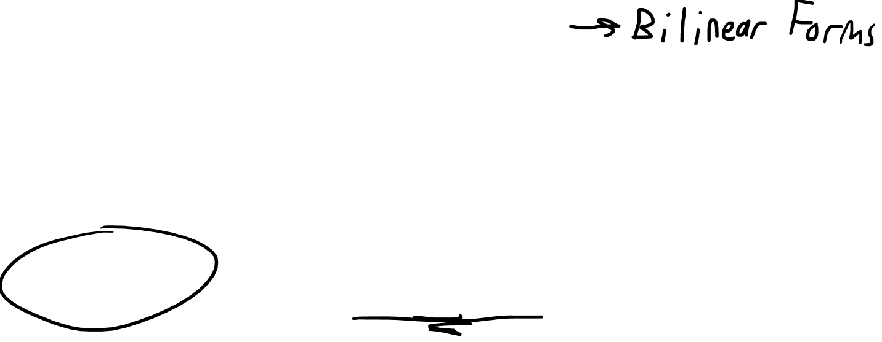

The Tensor Product
Part 2: Covector-Covector Pairs
Warning: Video contains
non-standard tensor product notation
$$ε^{i}ε^{j}$$
$$ε^{i}⊗ε^{j}$$

Slide 2
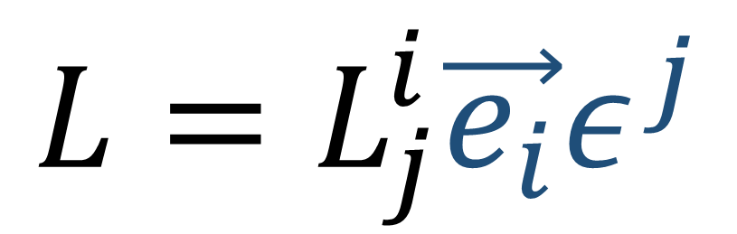
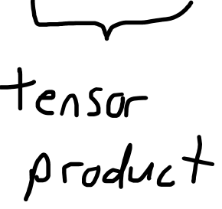
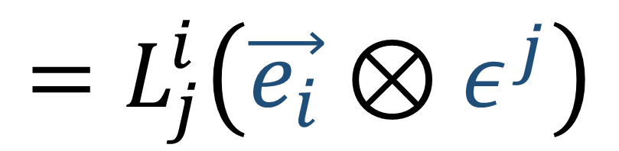
Linear maps = linear combinations of vector-covector pairs
$$L=L_{j}^{i}\vec{e_{i}}ε^{j}$$
$$=L_{j}^{i}\left(\vec{e_{i}}⊗ε^{j}\right)$$

Slide 3
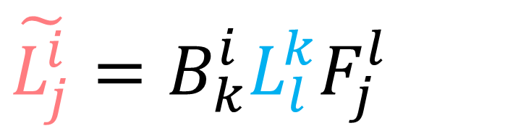
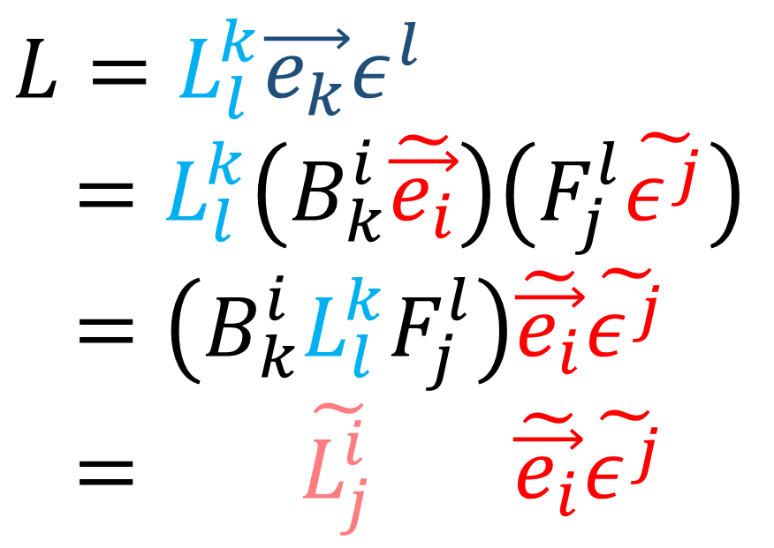

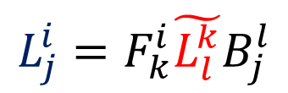


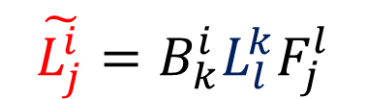

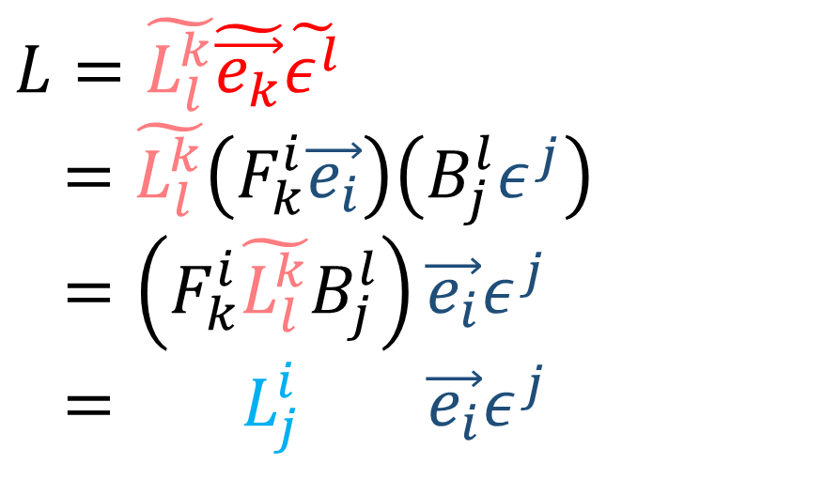

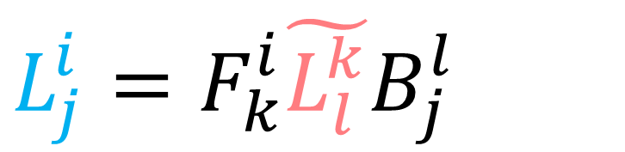
$$\tilde{L_{j}^{i}}=B_{k}^{i}L_{l}^{k}F_{j}^{l}$$
$$L=L_{l}^{k}\vec{e_{k}}ε^{l}$$
$=L_{l}^{k}\left(B_{k}^{i}\tilde{\vec{e_{i}}}\right)\left(F_{j}^{l}\tilde{ε^{j}}\right)$
$=\left(B_{k}^{i}L_{l}^{k}F_{j}^{l}\right)\tilde{\vec{e_{i}}}\tilde{ε^{j}}$
$= \tilde{L_{j}^{i}} \tilde{\vec{e_{i}}}\tilde{ε^{j}}$
$$L=\tilde{L_{l}^{k}}\tilde{\vec{e_{k}}}\tilde{ε^{l}}$$
$=\tilde{L_{l}^{k}}\left(F_{k}^{i}\vec{e_{i}}\right)\left(B_{j}^{l}ε^{j}\right)$
$=\left(F_{k}^{i}\tilde{L_{l}^{k}}B_{j}^{l}\right)\vec{e_{i}}ε^{j}$
$= L_{j}^{i} \vec{e_{i}}ε^{j}$
$$L_{j}^{i}=F_{k}^{i}\tilde{L_{l}^{k}}B_{j}^{l}$$
$$\tilde{\vec{e_{j}}}=F_{j}^{i}\vec{e_{i}}$$
$$\vec{e_{j}}=B_{j}^{i}\tilde{\vec{e_{i}}}$$
$$\tilde{ε^{i}} =B_{j}^{i}ε^{j}$$
$$L_{j}^{i}=F_{k}^{i}\tilde{L_{l}^{k}}B_{j}^{l}$$
$$ε^{i}=F_{j}^{i}\tilde{ε^{j}}$$
$$\tilde{L_{j}^{i}}=B_{k}^{i}L_{l}^{k}F_{j}^{l}$$

Slide 4
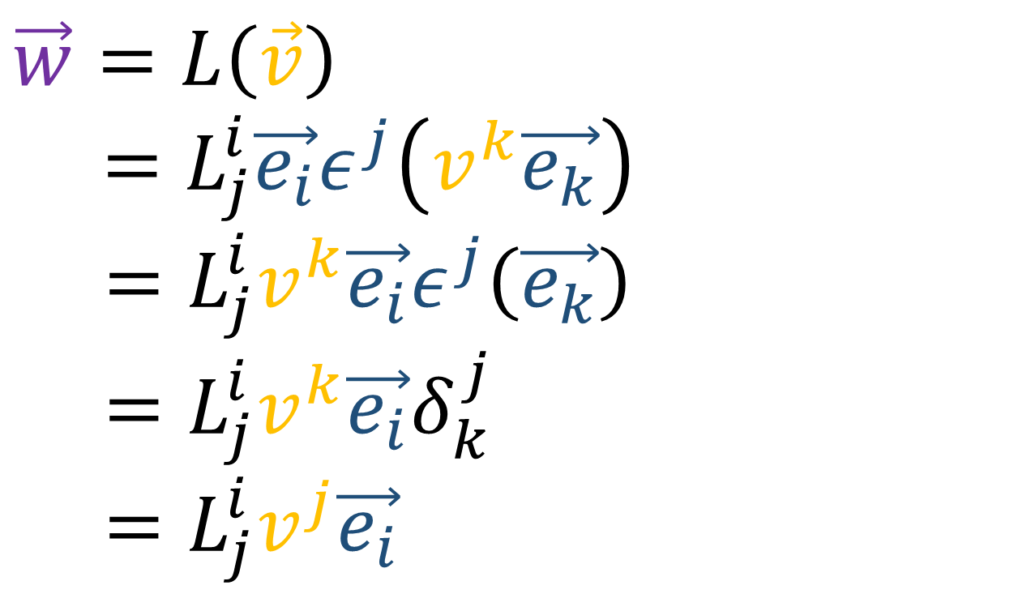
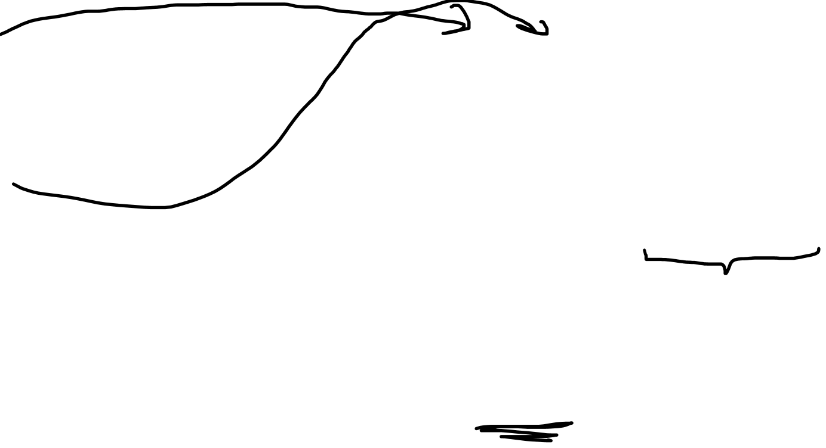
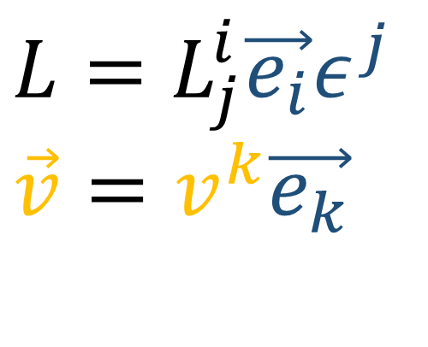
$$L=L_{j}^{i}\vec{e_{i}}ε^{j}$$
$$\vec{v}=v^{k}\vec{e_{k}}$$
$$\vec{w}=L\left(\vec{v}\right)$$
$=L_{j}^{i}\vec{e_{i}}ε^{j}\left(v^{k}\vec{e_{k}}\right)$
$=L_{j}^{i}v^{k}\vec{e_{i}}ε^{j}\left(\vec{e_{k}}\right)$
$=L_{j}^{i}v^{k}\vec{e_{i}}δ_{k}^{j}$
$=L_{j}^{i}v^{j}\vec{e_{i}}$

Slide 5
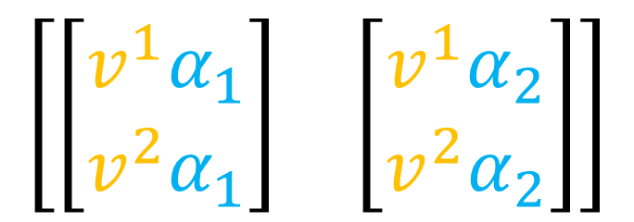
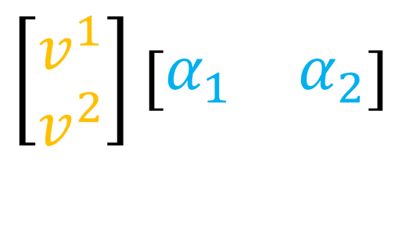
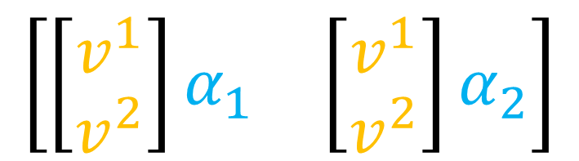
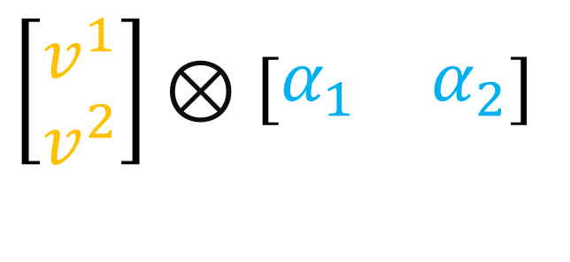

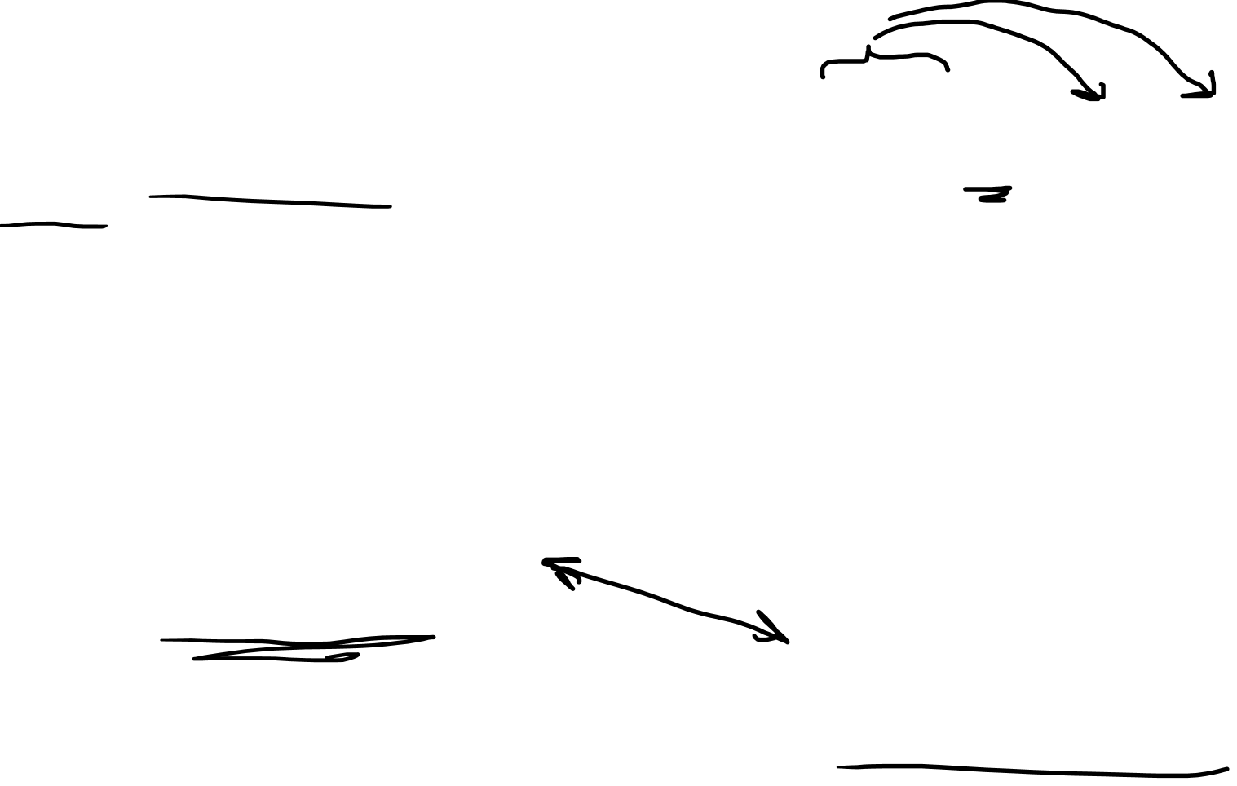
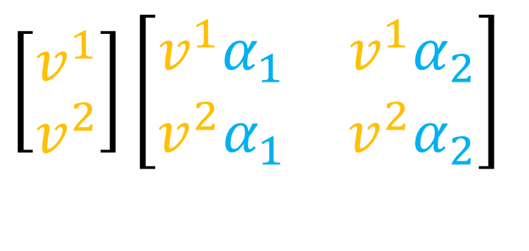
$$\left[\begin{aligned}v^{1} \\ v^{2}\end{aligned}\right]\left[\begin{matrix}α_{1} & α_{2}\end{matrix}\right]$$
$$\left[\begin{aligned}v^{1} \\ v^{2}\end{aligned}\right]⊗\left[\begin{matrix}α_{1} & α_{2}\end{matrix}\right]$$
$$\left[\begin{matrix}\left[\begin{aligned}v^{1} \\ v^{2}\end{aligned}\right]α_{1} & \left[\begin{aligned}v^{1} \\ v^{2}\end{aligned}\right]α_{2}\end{matrix}\right]$$
$$\left[\begin{matrix}α_{1} & α_{2}\end{matrix}\right]$$
$$\left[\begin{aligned}v^{1} \\ v^{2}\end{aligned}\right]\left[\begin{matrix}\begin{aligned}v^{1}α_{1} \\ v^{2}α_{1}\end{aligned} & \begin{aligned}v^{1}α_{2} \\ v^{2}α_{2}\end{aligned}\end{matrix}\right]$$
$$\left[\begin{matrix}\left[\begin{aligned}v^{1}α_{1} \\ v^{2}α_{1}\end{aligned}\right] & \left[\begin{aligned}v^{1}α_{2} \\ v^{2}α_{2}\end{aligned}\right]\end{matrix}\right]$$

Slide 6
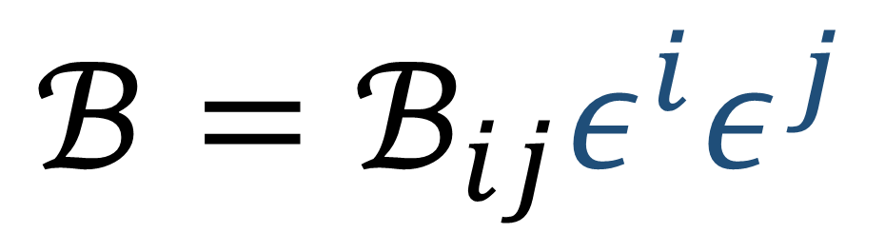
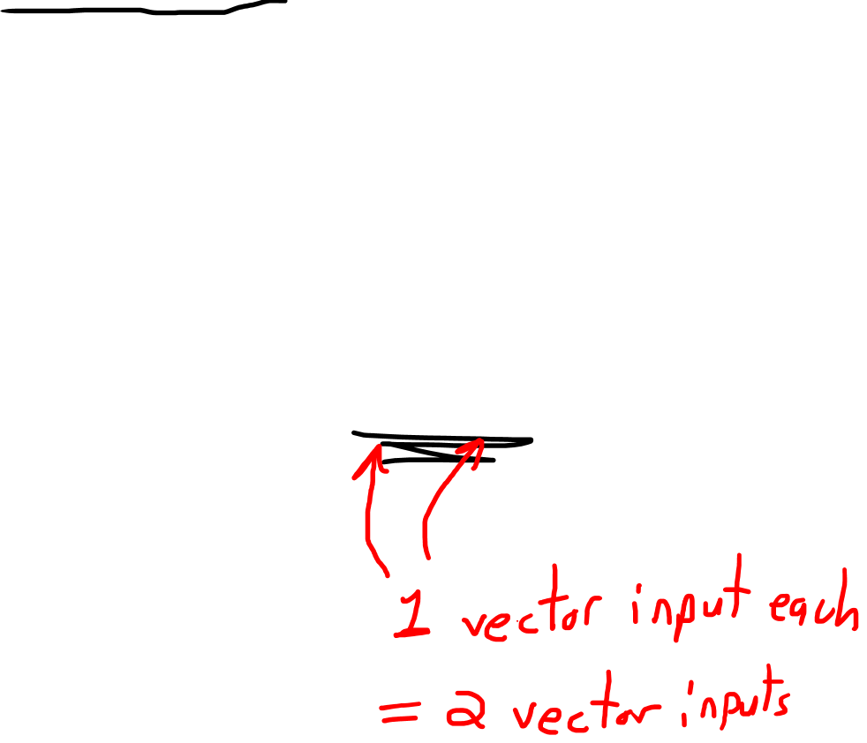
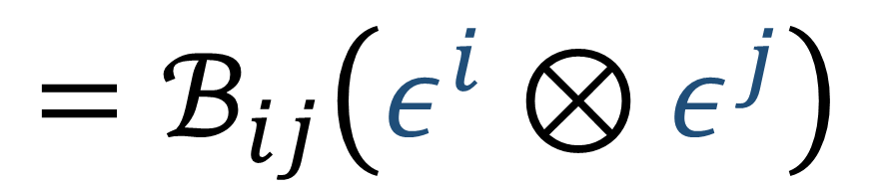
Bilinear Forms = linear combinations of covector-covector pairs
(including metric tensor)
$$ℬ=ℬ_{ij}ε^{i}ε^{j}$$
$$=ℬ_{ij}\left(ε^{i}⊗ε^{j}\right)$$

Slide 7

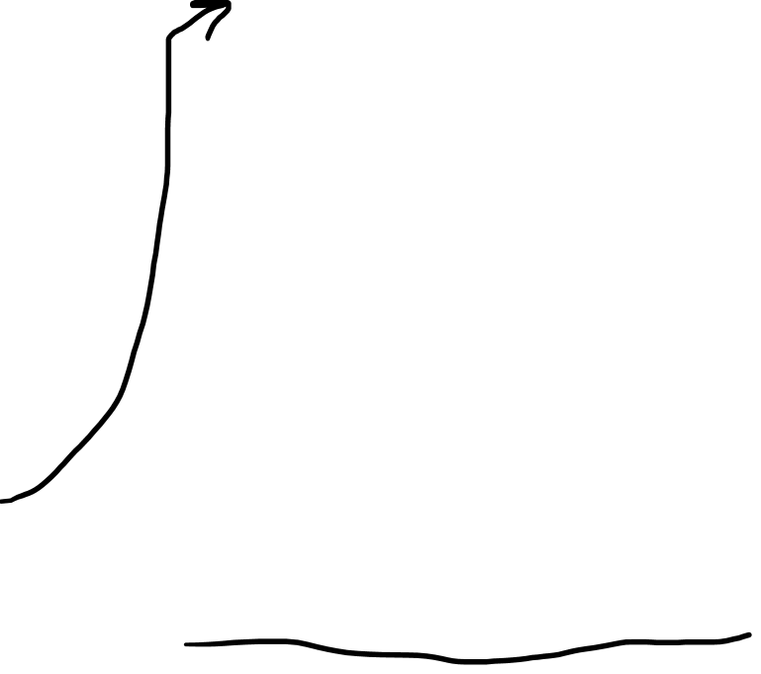
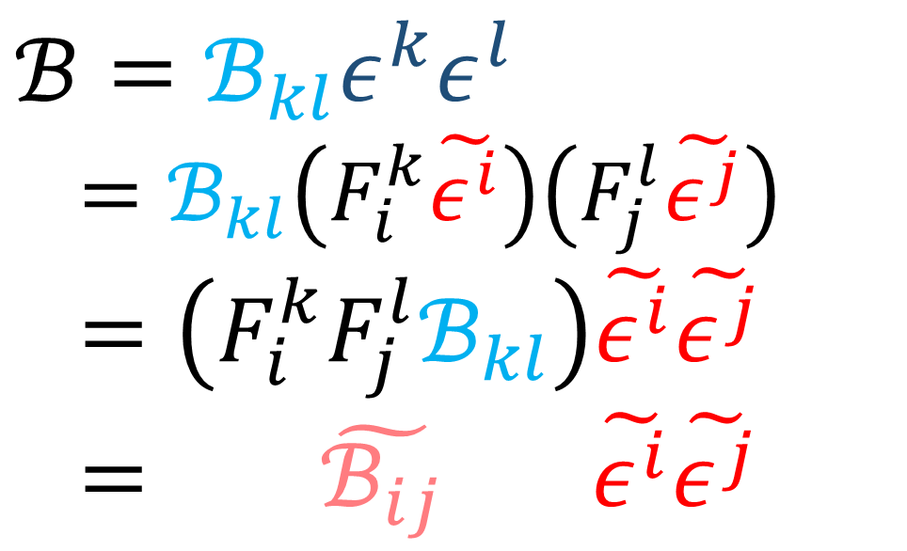

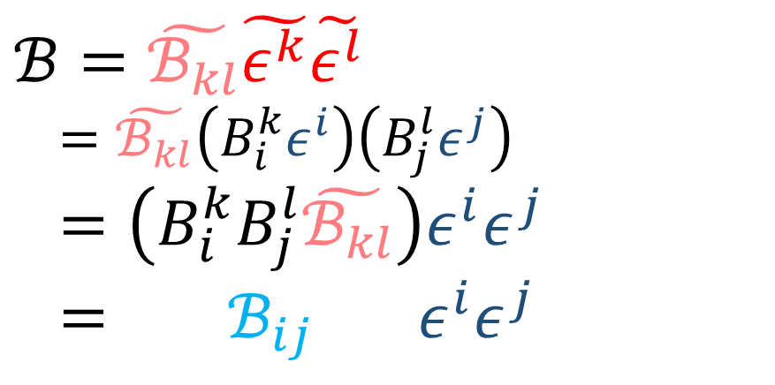

$$ℬ=ℬ_{kl}ε^{k}ε^{l}$$
$=ℬ_{kl}\left(F_{i}^{k}\tilde{ε^{i}}\right)\left(F_{j}^{l}\tilde{ε^{j}}\right)$
$=\left({F_{i}^{k}F_{j}^{l}ℬ}_{kl}\right)\tilde{ε^{i}}\tilde{ε^{j}}$
$= \tilde{ℬ_{ij}} \tilde{ε^{i}}\tilde{ε^{j}}$
$$ℬ=\tilde{ℬ_{kl}}\tilde{ε^{k}}\tilde{ε^{l}}$$
$=\tilde{ℬ_{kl}}\left(B_{i}^{k}ε^{i}\right)\left(B_{j}^{l}ε^{j}\right)$
$=\left(B_{i}^{k}B_{j}^{l}\tilde{ℬ_{kl}}\right)ε^{i}ε^{j}$
$= ℬ_{ij} ε^{i}ε^{j}$
$$\tilde{ℬ_{ij}}=F_{i}^{k}F_{j}^{l}ℬ_{kl}$$
$$ℬ_{ij}=B_{i}^{k}B_{j}^{l}\tilde{ℬ_{kl}}$$
$$\tilde{\vec{e_{j}}}=F_{j}^{i}\vec{e_{i}}$$
$$\vec{e_{j}}=B_{j}^{i}\tilde{\vec{e_{i}}}$$
$$\tilde{ε^{i}} =B_{j}^{i}ε^{j}$$
$$ℬ_{ij}=B_{i}^{k}B_{j}^{l}\tilde{ℬ_{kl}}$$
$$ε^{i}=F_{j}^{i}\tilde{ε^{j}}$$
$$\tilde{ℬ_{ij}}={F_{i}^{k}F_{j}^{l}ℬ}_{kl}$$

Slide 8
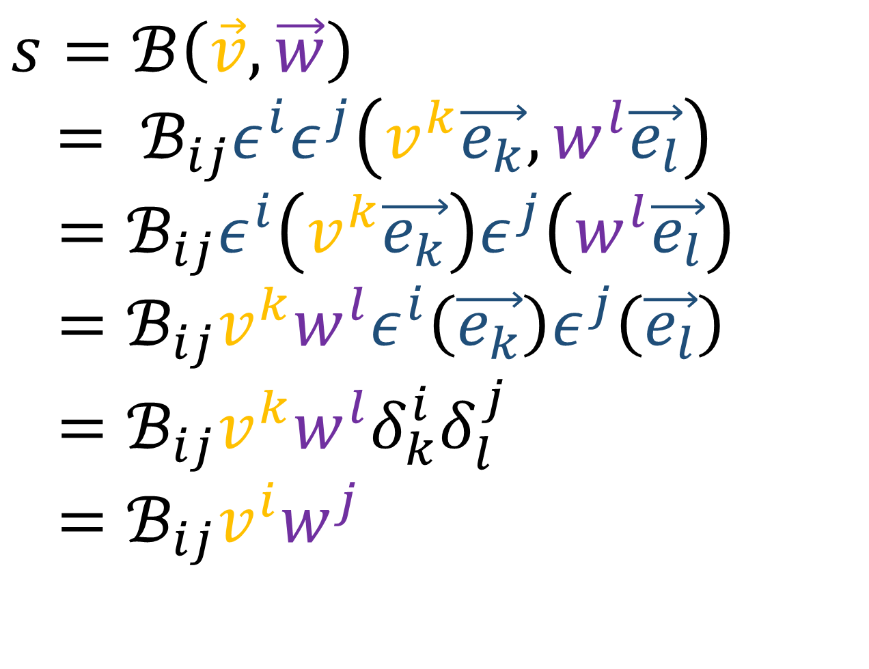
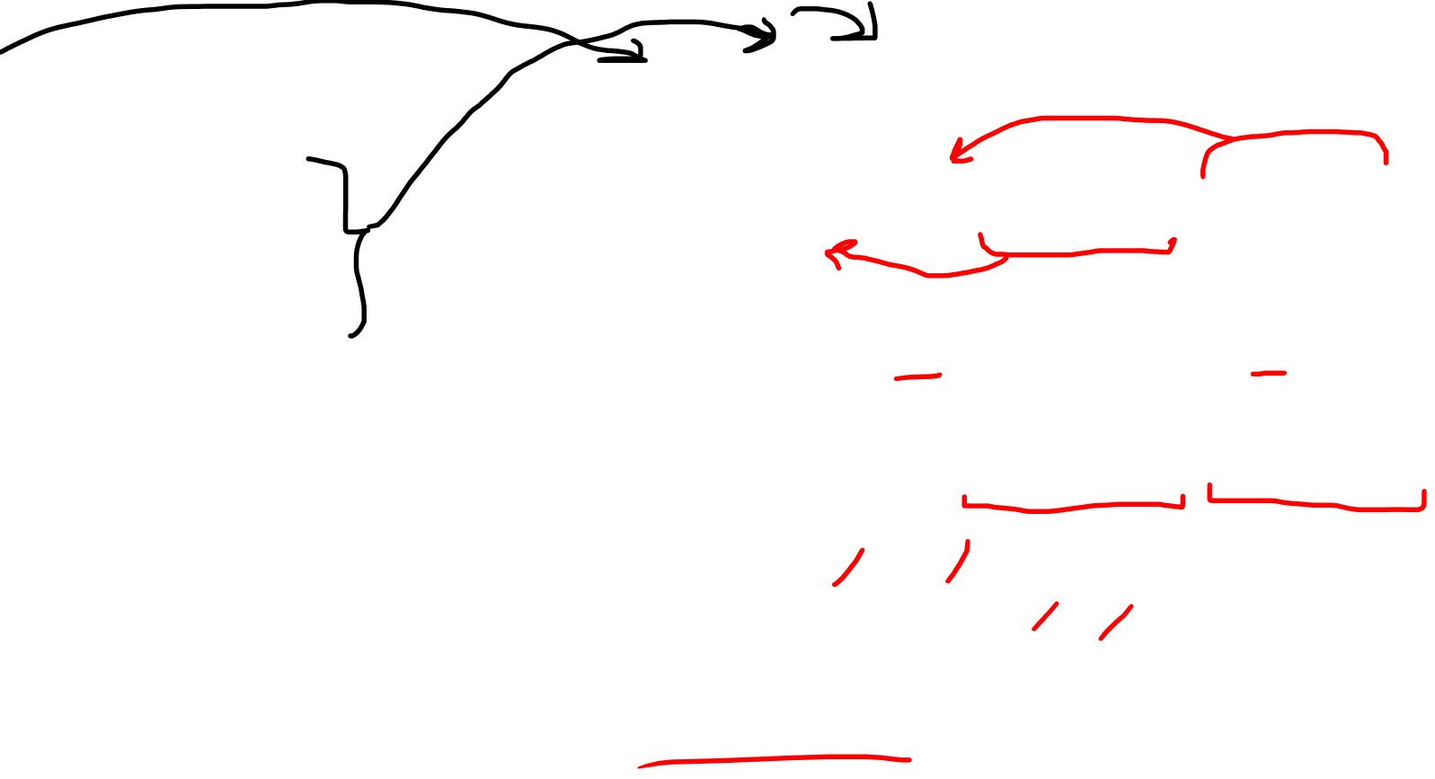
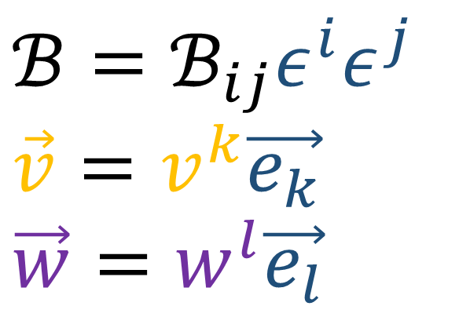
$$ℬ=ℬ_{ij}ε^{i}ε^{j}$$
$$\vec{v}=v^{k}\vec{e_{k}}$$
$$\vec{w}=w^{l}\vec{e_{l}}$$
$$s=ℬ\left(\vec{v},\vec{w}\right)$$
$= ℬ_{ij}ε^{i}ε^{j}\left(v^{k}\vec{e_{k}},w^{l}\vec{e_{l}}\right)$
$=ℬ_{ij}ε^{i}\left(v^{k}\vec{e_{k}}\right)ε^{j}\left(w^{l}\vec{e_{l}}\right)$
$=ℬ_{ij}v^{k}w^{l}ε^{i}\left(\vec{e_{k}}\right)ε^{j}\left(\vec{e_{l}}\right)$
$=ℬ_{ij}v^{k}w^{l}δ_{k}^{i}δ_{l}^{j}$
$=ℬ_{ij}v^{i}w^{j}$

Slide 9
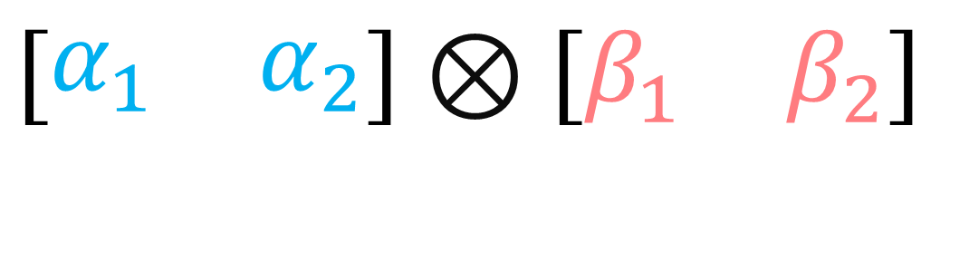
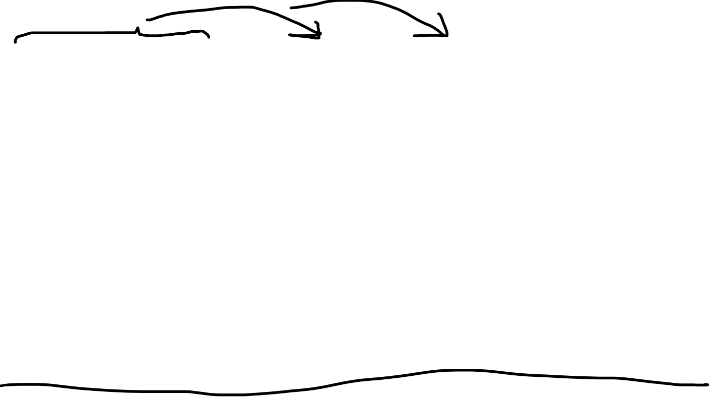
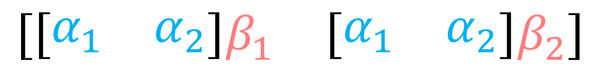
$$\left[\begin{matrix}α_{1} & α_{2}\end{matrix}\right]⊗\left[\begin{matrix}β_{1} & β_{2}\end{matrix}\right]$$
$$\left[\begin{matrix}{\left[\begin{matrix}α_{1} & α_{2}\end{matrix}\right]β}_{1} & {\left[\begin{matrix}α_{1} & α_{2}\end{matrix}\right]β}_{2}\end{matrix}\right]$$
$$\left[\begin{matrix}\left[\begin{matrix}α_{1}β_{1} & α_{2}\end{matrix}β_{1}\right] & \left[\begin{matrix}α_{1}β_{2} & α_{2}β_{2}\end{matrix}\right]\end{matrix}\right]$$

Slide 10
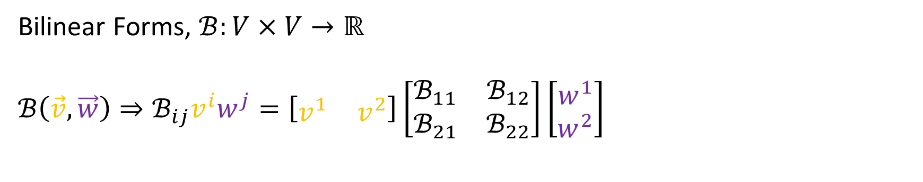
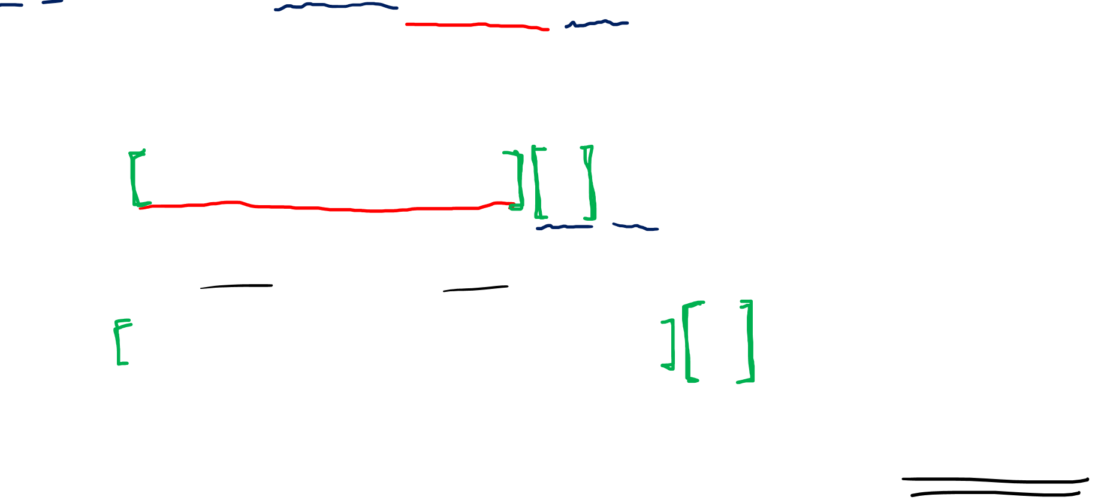

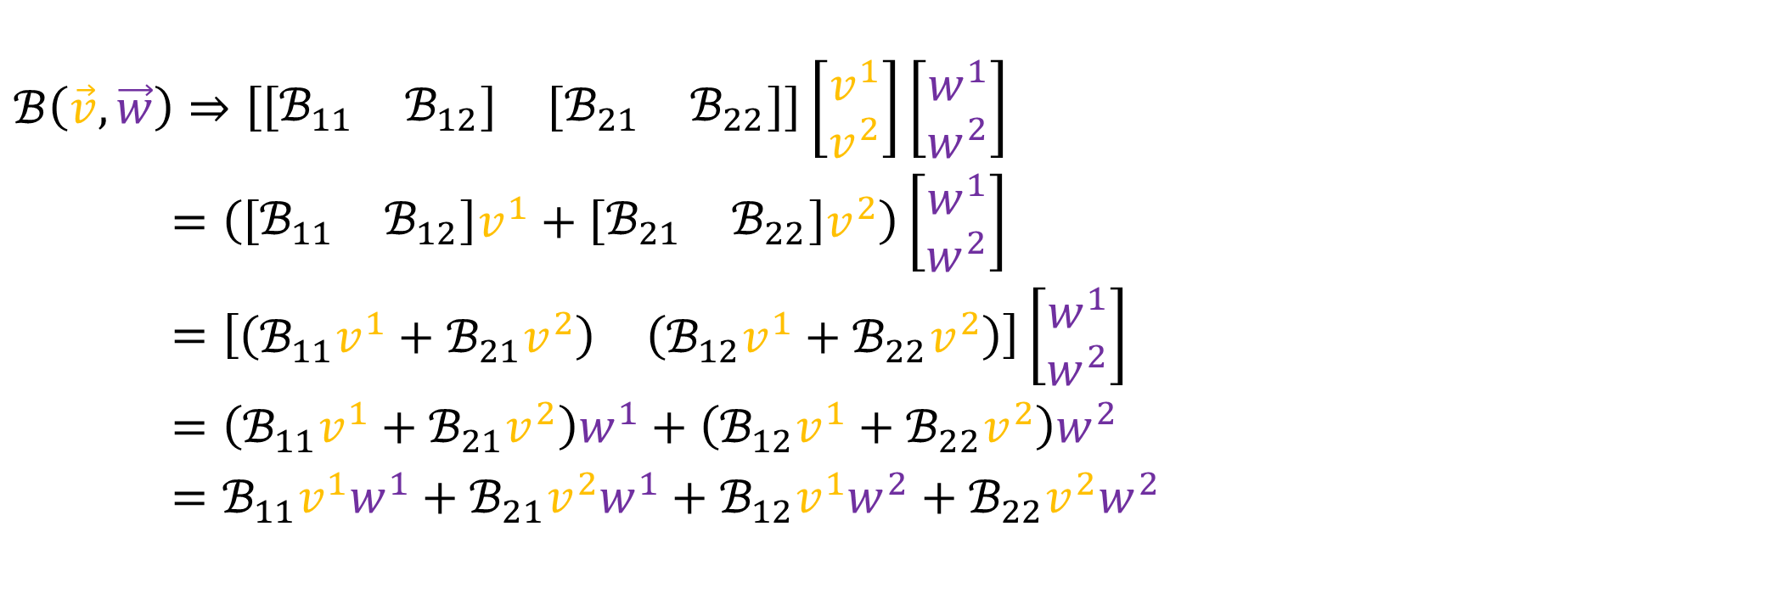
Bilinear Forms, $ℬ:V×V→ℝ$
$$ℬ\left(\vec{v},\vec{w}\right)⇒ℬ_{ij}v^{i}w^{j}=\left[\begin{matrix}v^{1} & v^{2}\end{matrix}\right]\left[\begin{matrix}ℬ_{11} & ℬ_{12} \\ ℬ_{21} & ℬ_{22}\end{matrix}\right]\left[\begin{aligned}w^{1} \\ w^{2}\end{aligned}\right]$$
Awkward?
$$ℬ\left(\vec{v},\vec{w}\right)⇒\left[\begin{matrix}\left[\begin{matrix}ℬ_{11} & ℬ_{12}\end{matrix}\right] & \left[\begin{matrix}ℬ_{21} & ℬ_{22}\end{matrix}\right]\end{matrix}\right]\left[\begin{matrix}v^{1} \\ v^{2}\end{matrix}\right]\left[\begin{aligned}w^{1} \\ w^{2}\end{aligned}\right]$$
$=\left(\left[\begin{matrix}ℬ_{11} & ℬ_{12}\end{matrix}\right]v^{1}+\left[\begin{matrix}ℬ_{21} & ℬ_{22}\end{matrix}\right]v^{2}\right)\left[\begin{aligned}w^{1} \\ w^{2}\end{aligned}\right]$
$=\left[\begin{matrix}\left(ℬ_{11}v^{1}+ℬ_{21}v^{2}\right) & \left(ℬ_{12}v^{1}+ℬ_{22}v^{2}\right)\end{matrix}\right]\left[\begin{aligned}w^{1} \\ w^{2}\end{aligned}\right]$
$=\left(ℬ_{11}v^{1}+ℬ_{21}v^{2}\right)w^{1}+\left(ℬ_{12}v^{1}+ℬ_{22}v^{2}\right)w^{2}$
$=ℬ_{11}v^{1}w^{1}+ℬ_{21}v^{2}w^{1}+ℬ_{12}v^{1}w^{2}+ℬ_{22}v^{2}w^{2}$
$$=ℬ_{ij}v^{i}w^{j}$$

Slide 11

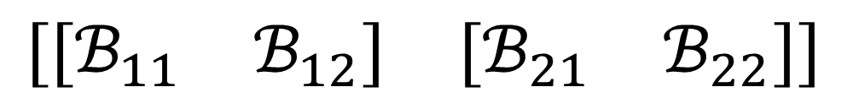





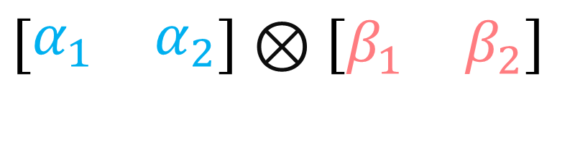
Bilinear Forms (new definition)…
Linear combinations of covector-covector pairs
$$ℬ=ℬ_{ij}ε^{i}ε^{j}$$
$$\tilde{ε^{i}} =B_{j}^{i}ε^{j}$$
$$\tilde{ℬ_{ij}}=F_{i}^{k}F_{j}^{l}ℬ_{kl}$$
$$ℬ_{ij}=B_{i}^{k}B_{j}^{l}\tilde{ℬ_{kl}}$$
$$\left[\begin{matrix}α_{1} & α_{2}\end{matrix}\right]⊗\left[\begin{matrix}β_{1} & β_{2}\end{matrix}\right]$$
$$ε^{i}=F_{j}^{i}\tilde{ε^{j}}$$
$$ℬ_{ij}ε^{i}ε^{j}$$
$$ℬ_{ij}v^{i}w^{i}$$
$$\left[\begin{matrix}\left[\begin{matrix}ℬ_{11} & ℬ_{12}\end{matrix}\right] & \left[\begin{matrix}ℬ_{21} & ℬ_{22}\end{matrix}\right]\end{matrix}\right]$$

